Slide 1

Maritime Day
Maritime Cyber Resilience and Security in the light of new regulations IACS UR E26 / UR E27
Shaun Reardon DNV Maritime Cyber Security Advisory

Slide 2

Who am I and why should you listen to me?
With DNV cybersecurity since August 2020
Head of Section – Industrial Systems Cyber Security
CISSP | GICSP | CCSK | CSTP | CBCI | Lead Auditor ISO 27001
Former detective at Scotland Yard, London UK for 26 years
Counter-terrorism, Witness protection, National Hi-Tech Crime Unit, International Organised Crime, Kidnap & Human Trafficking, Intelligence, Economic crime.
Specialising in
IT, cyber and digital forensics
Criminal Intelligence
Financial investigation & money laundering
40 countries globally

Slide 3



Safety in shipping today heavily depends on cyber systems
Information Technology (IT)
At risk:
Mainly
finance
and
reputation
IT networks, servers and clients supporting:
E-mail services,
Administration, accounts, crew lists, …
Planned Maintenance,
Spares management and requisitioning,
Electronic manuals,
Electronic certificates,
Permits to work,
Charter party, notice of readiness, bill of lading…
on-shore org.
Operation Technology (OT)
At risk:
Life,
property
and
environment
+
all of the
above
On-board measurement and control,
ECDIS,
Power management,
GPS, CCTV,
Remote support for engines,
Data loggers,
Engine control,
Dynamic positioning,
And generally: PLCs and other automation
devices
Notes:
Firstly, today safety in shipping heavily depends on cyber systems.
Many of these systems are not only business critical, they also have a significant safety impact.
In addition to what we normally think of when talking about cyber security, such as IT networks, email…., on board a ship, cyber security is also affecting the operational technology, such as PLCs (Automation) and navigation equipment…
Cyber security is the art of addressing the risks for both the IT & OT systems.

Slide 4
Digitalization in the Maritime world in the last 10 years: Growing complexity creates new challenges
Increased automation and “aids” to crew
Increased communication from shore to ship and vice-versa: office, port, charterers, etc.
Remote condition monitoring: vibrations, pressure, temperature, etc.
Remote maintenance
Remote access to control systems
Remote optimizations: route layout, navigation, decarbonization or lower carbon dioxide production
Software & Automation
Crew size
Interconnectivity

Slide 5
Reports of incidents around the world are increasing
Pirate attack supported by cyber attack
Hackers took “full control” of navigation systems for 10 h
VSAT hacking using common login
Loss of fuel control and ballast water valves due to ECDIS update
PMS system shore and vessel attack
Loss of main switchboard due to ransomware
ECIDS ransomware and chart spoofing
GPS jamming and spoofing
Malware allows full access to vessel systems
Hackers caused IMO’s website in 2020 to go down
Hacking of cargo tracking system for smuggling purposes
AIS spoofing
Notes:
So, cyber security threats are progressing and there has been a number of cases, as illustrated in the figure, confirming the impact on the maritime industry.
Add FireEyes.

Slide 6
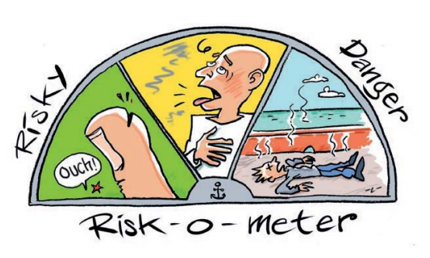
Current state of the art in the Maritime Industry
The maritime industry is generally not well prepared
Digitalization will increase opportunities for cyber incidents
Cyber attacks are getting more dangerous and more prevalent year after year

Slide 7

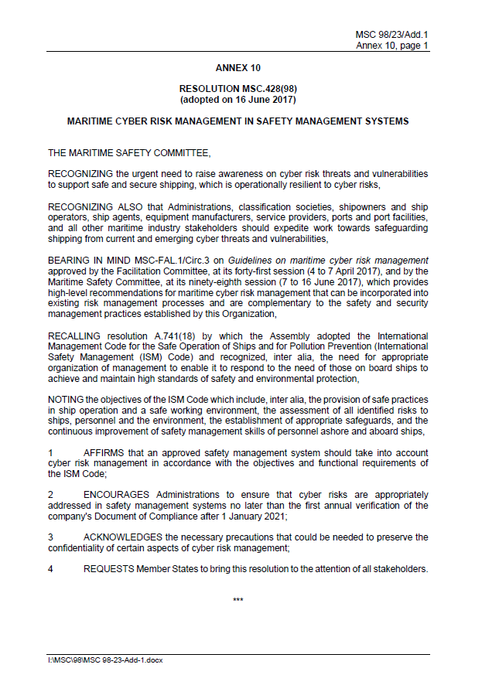
IMO Resolution MSC.428(98)
AFFIRMS that … safety management system should take into account cyber risk management in accordance with the ISM Code.
Where to start: MSC-FAL.1/Circ.3
  IT and OT systems
  Identify – Protect – Detect – Respond – Recover
  referring to international best practices
However, not addressing:
  how to assess the risk,
  prescriptive or goal-based safety requirements,
  Yard or vendor activities.
Impact:
Cyber risks should be addressed in safety management systems no later than the first annual verification of DoC after 1 January 2021. This is a non-mandatory requirement, but flag states may (and do) make it mandatory.
Notes:
Not suggesting which are the topics to be addressed in the SMS to ensure effective and relevant cyber risk management onboard a vessel.

Slide 8
4 - DNV Cyber Secure Class Notation and Recommended practices
Notes:
The new DNV RP on Cyber Security – how does it work ?

Slide 9

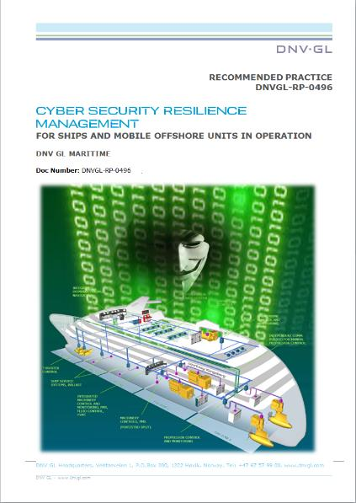

CUSTOMER FEEDBACK
CYBER SECURITY DNV-RP-0496
“Looks really good, best CS guideline out there”
Passenger company
This RP is a comprehensive document that provides a good approach to Cyber Security for ICS*“
Shipping manager
“We embrace this approach, thumbs up for the initiative”
Shipping manager
“This RP makes a lot of sense”
Shipping manager
“This RP is absolutely useful in bridging the gap between the IT & OT* worlds”
Shipping manager
“Generally very good approach and description of the requirements”
Gov. agency
“Outstanding guidance that can be easily understood and embraced by most organizations”
Flag state
“Good overview of the recommended process with supporting tables, examples, checklists etc. Overall well done!”
Shipping manager
*OT: Operational Technology (Automation, Sensors, Industrial Control Systems (ICS)
Notes:
One focus on DNV-RP-0496, as a comprehensive help for achieving cybersecurity resilience, bringing together the various guidelines to produce a useful method and way forward.

Slide 10

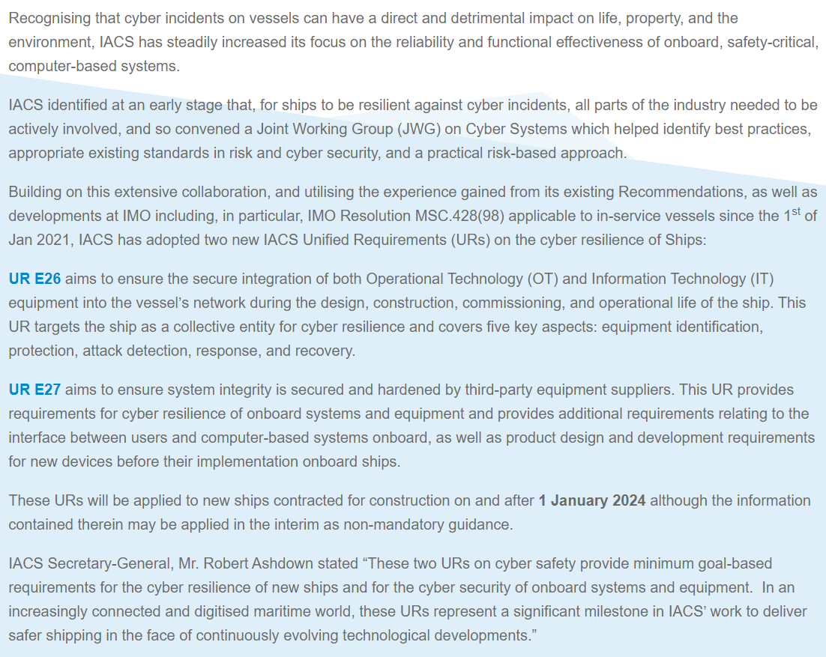
IACS released Unified Requirements on Cyber Security for ships and ship’s systems
Applies to new ships contracted for construction on and after 1 January 2024. May be applied in the interim as non-mandatory class notation.
UR E26 secure integration of Operational Technology (OT) and Information Technology (IT) equipment interfaces into the vessel’s network architecture during the design, construction and commissioning of the ship – owners and yards.
UR E27 ensure system integrity secured and hardened by 3rd equipment suppliers and provides requirements for cyber resilience of onboard systems, including Secure Development Life Cycle (SDLC) – suppliers.
A new revision of these UR’s will look at survey requirements.
Supports owner with concrete barriers to meet IMO resolution MSC.428(98).
Vendors of onboard automation and navigation systems should act now due to potential longer development process.
IACS UR E26 and UR E27 are implemented or will be implemented in all major Class Societies, such as DNV
DNV’s current cyber security rules with more than 100 vessels & systems contracted is fully aligned with IACS URs, both being based on the recognized standard IEC 62443.

Slide 11
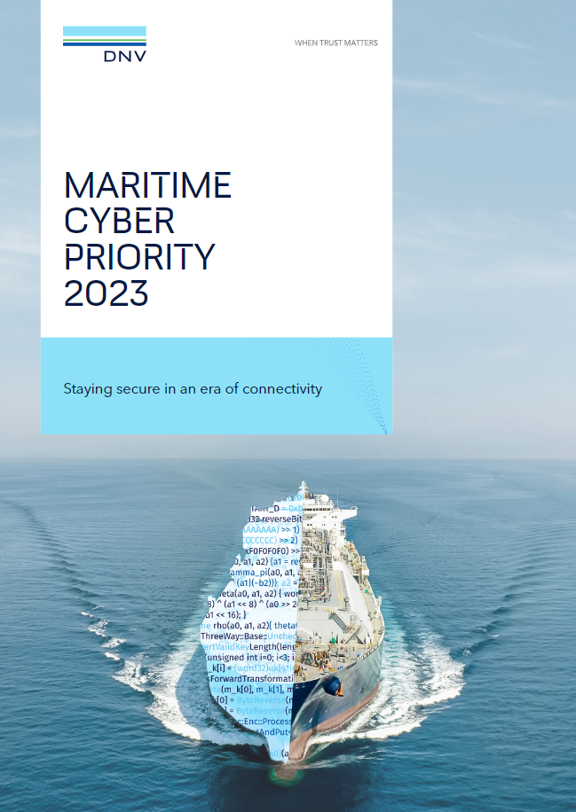
The Maritime Cyber Priority
Launch 6th of June
Research exploring changing attitudes and approaches to cyber security in the Maritime sector drawing on the broad opinions of industry professionals.
Based on a survey of DNV customers and in-depth interviews, together with DNV expertise we explore:
How real is the industry’s awareness of the threat?
What action is being taken to prevent it?
Where is investment being prioritized?
What are the drivers and barriers for cyber security?
Notes:
DNV’s Maritime Cyber Priority research explores the changing attitudes and approaches to cyber security in key industrial sectors. The research draws on surveys of industry professionals complemented by in-depth interviews with leaders and experts. ​
In June 2023, we will publish the latest edition of the research
​
Maritime Cyber Priority 2023: Staying secure in an era of connectivity​
Research based on a survey of 801 maritime professionals conducted in March and April 2023. Survey respondents represent a range of subsectors and functions within the industry, including those with in-depth knowledge of cyber security along with general managers and C-suite executives. ​
The survey is complemented by in-depth interviews with leaders and experts from the likes of the US Coast Guard, Wärtsilä, Meyer Werft, Yinson, Bundeswehr (German navy), Stena Drilling, Beazley, Hamburg Port Authority, UK Chamber of Shipping, and DNV.​
We bring this together with DNV experience and expertise.​
​

Slide 12
Thank you very much for your attention!
DNV Maritime Cyber Security Advisory
E-Mail:
Shaun.Reardon@dnv.com, Thierry.Coq@dnv.com

