Slide 1
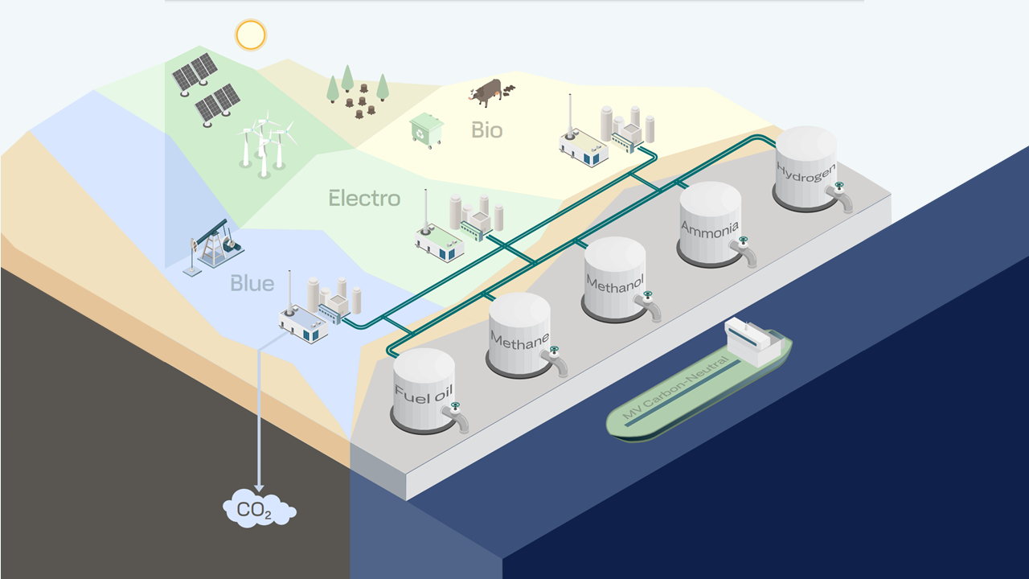
Nordic Roadmap
for Future Fuels
Maritime Day Åland June 1, 2023
Dorthe Alida Slotvik & Ingeranne Strøm Nakstad, DNV Maritime – Environment Advisory

Slide 2
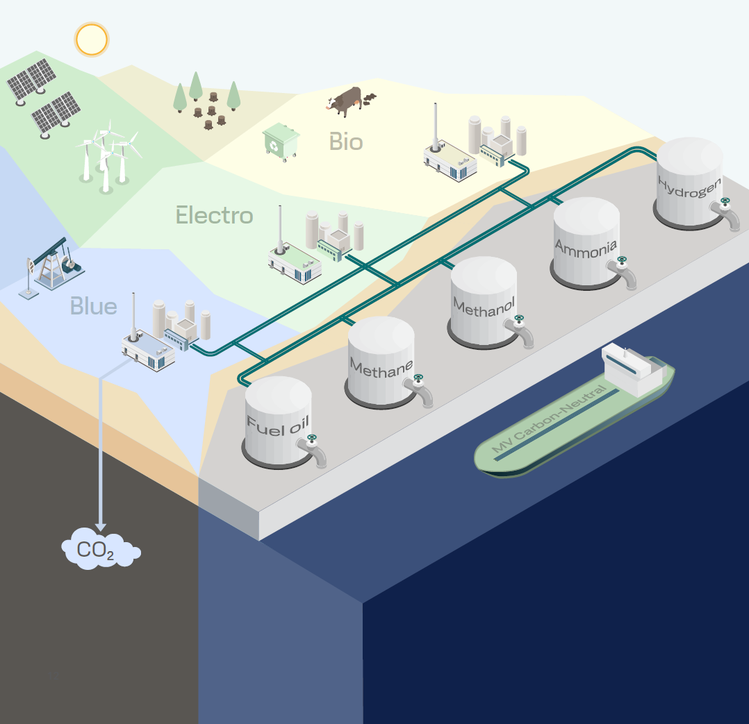
The Nordic roadmap project (2022 - 2025)
Overall aim: Reduce key barriers to implementation and establish a common roadmap for the whole Nordic region and logistics ecosystem towards zero-emission shipping.
Objectives:
Gain technical knowledge and regulatory development
Establish a Nordic collaboration platform and piloting
Develop a Nordic roadmap for future fuels
Linked to the project is:
The Pre-pilot project (2022-2023), focusing on identifying potential green shipping corridors which can be realized by the middle of this decade.
DNV (2022), Maritime Forecast to 2050
2
https://futurefuelsnordic.com/

Slide 3
The Nordic commitment
Declaration on Zero Emission Shipping by 2050 (COP26, November 2021)
Clydebank Declaration for green shipping corridors (COP26, November 2021)
Ministerial Declaration on zero emission shipping routes between the Nordic countries (May 2022)
Joint Statement by the Nordic Prime Ministers on a Sustainable Ocean Economy and the Green Transition (August 2022)

Slide 4
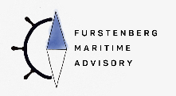
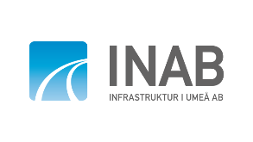
More than 35 partners
Co-operation platform
Contributing partners:
For more information, visit the project website:
https://futurefuelsnordic.com/
Supporting partners:
https://futurefuelsnordic.com/partners-and-contributors/

Slide 5
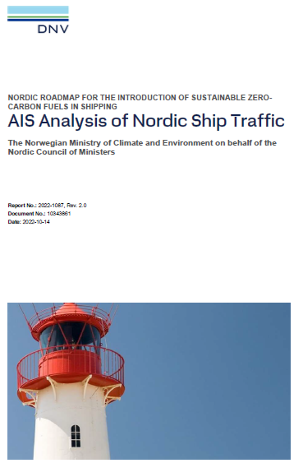
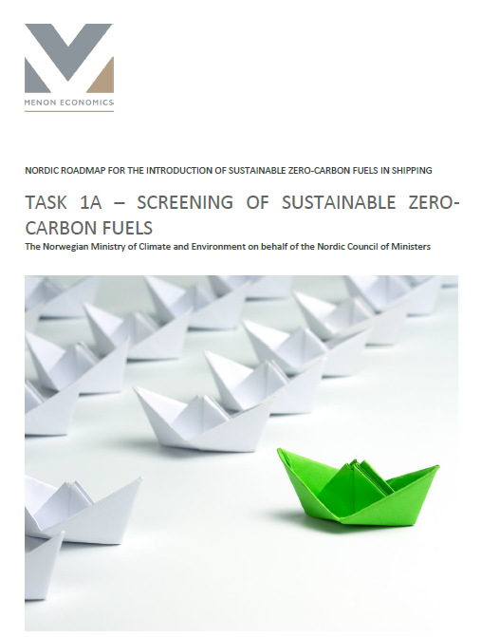
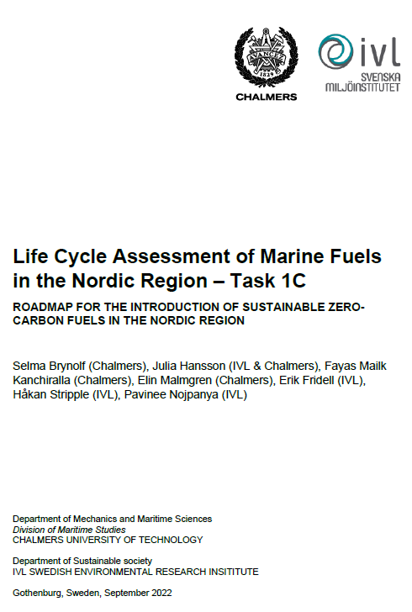
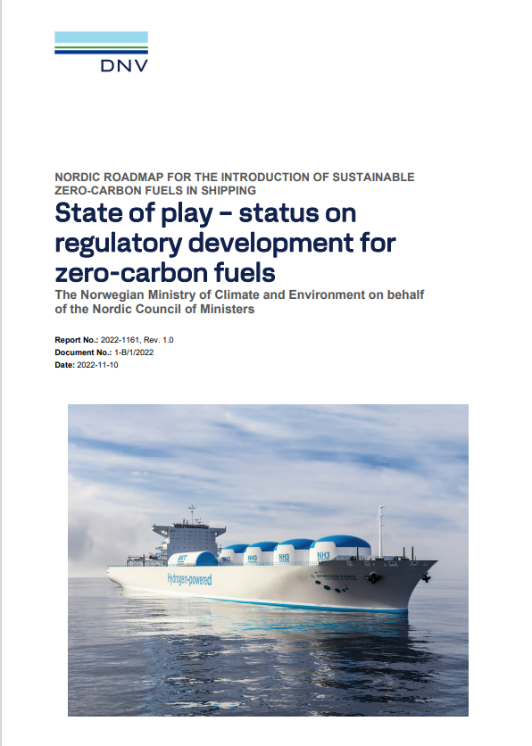
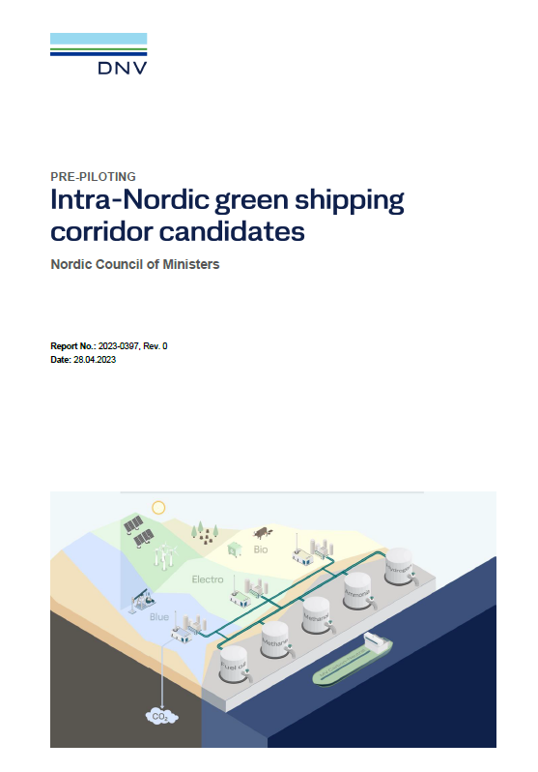
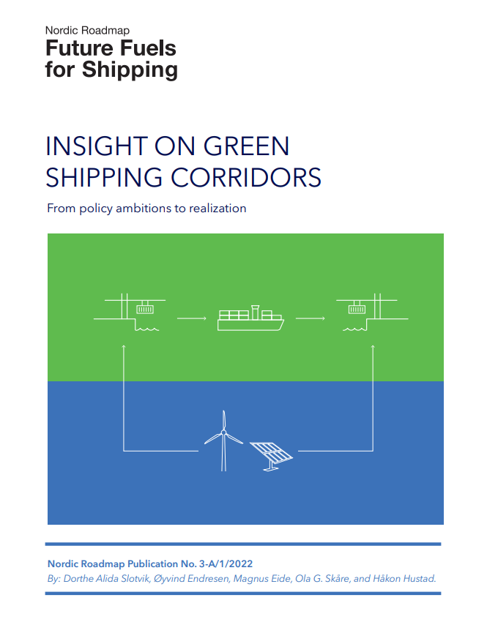
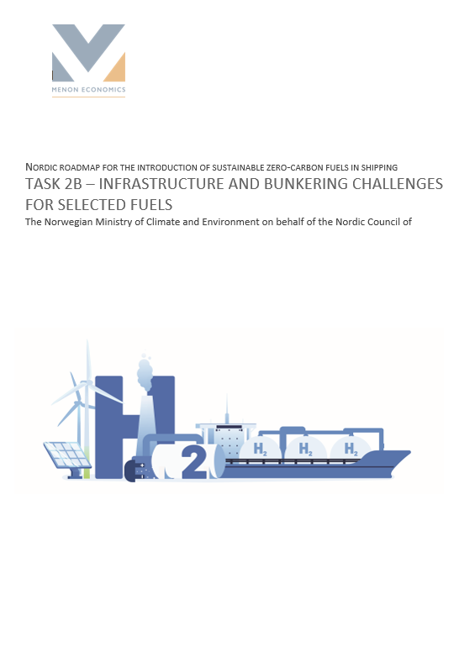
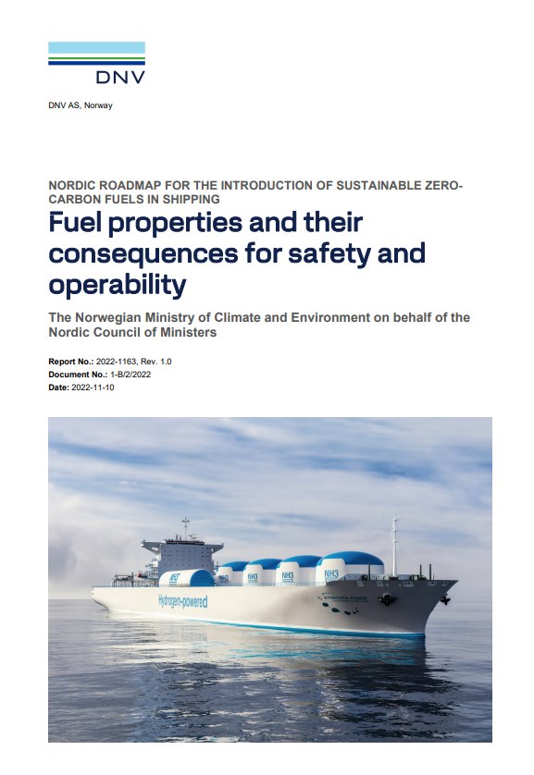
Eight technical deliverables to date
Available at: https://futurefuelsnordic.com/project-deliverables/
Pre-Piloting project (not published yet)

Slide 6
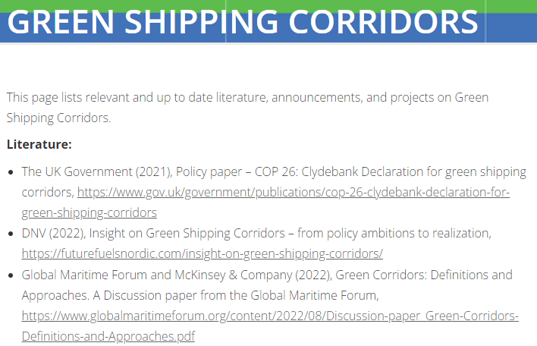
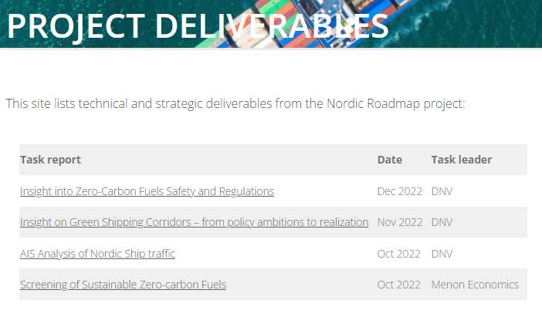
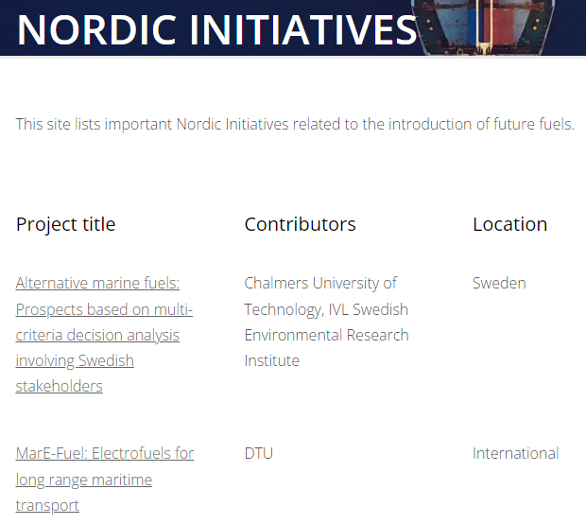
Project website – Knowledge Base

Slide 7
Key highlights from our deliverables
81 potential green corridors identified
LCA for 28 green fuel and propulsion combinations
3 key bottlenecks for fuel uptake
Technical and regulatory analysis for Ammonia, Hydrogen and Methanol
6 green corridors shortlisted*
140 fuel production assets
* Through the pre-Piloting project
https://futurefuelsnordic.com/project-deliverables/

Slide 8
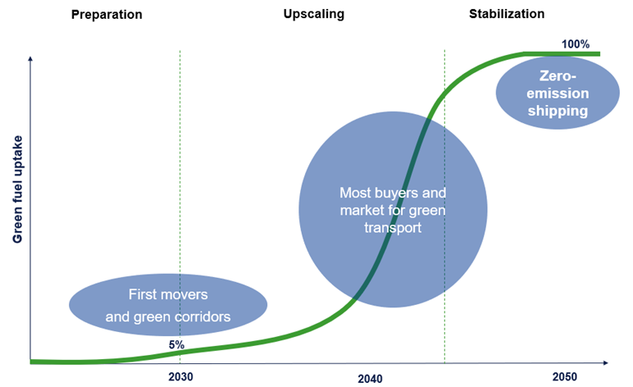
Nordic Fuel Transition Roadmap
Aims to accelerate the uptake of green fuels
Assumes that the fuel transition follows an S-curve
Details stakeholder actions to overcome barriers
Green shipping corridors as key enablers for acceleration
Critical for success to get input from all players in the maritime value chain
The pace needs to increase!
Today
The S-curve can describe the market development of many new technologies, including up-take of LNG and battery powered ships

Slide 9
Pre-piloting project (1-year duration)
Overall aim:
Identify potential Green Shipping Corridors that can be realized by the middle of this decade
Objectives:ng routes for decarbonization
Identification of specific intra-Nordic shipping routes for decarbonization
Identification of relevant and interested actors that can enter partnerships for specific projects for decarbonization of the identified routes
Establish partnerships for specific projects for decarbonization of the routes
DNV (2022), Maritime Forecast to 2050
9

Slide 10
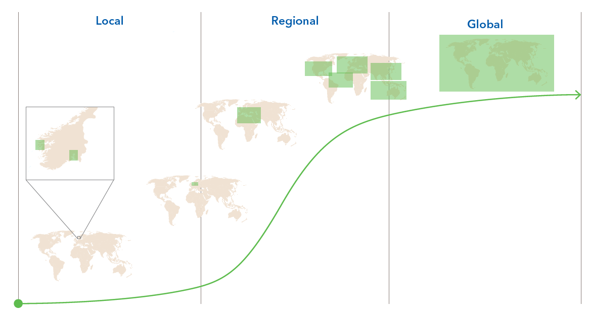
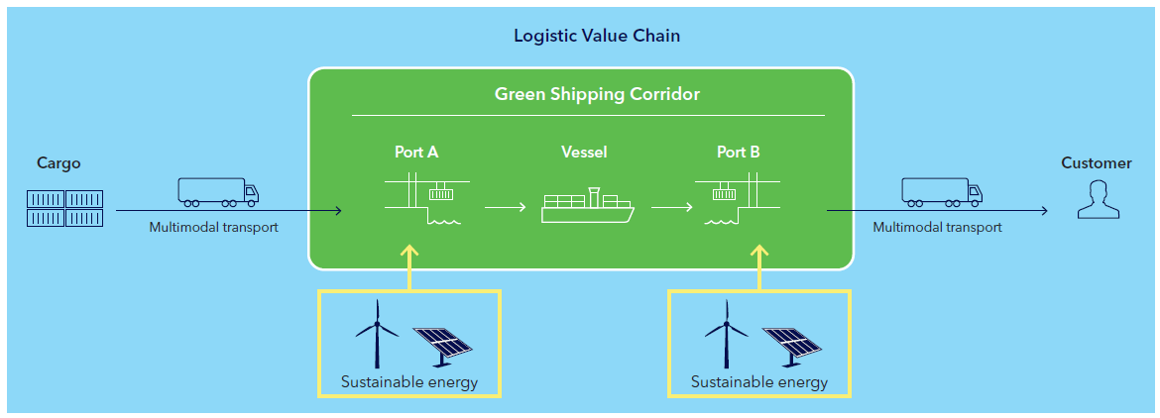
What is a green shipping corridor?
Zero-emission maritime route between two (or more) ports
Identifies barriers and actions to overcome them by involving stakeholders
Key enabler to accelerate the uptake of zero-emission fuels

Slide 11
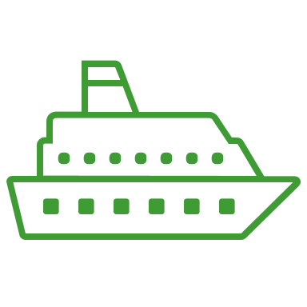
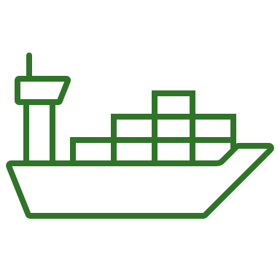
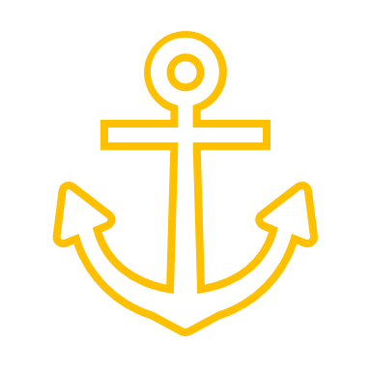
Work process for the Pre-piloting activities
Long list (81+)
Short list (6x)
Barrier workshops
Step 1: High-level screening of potential GSC and initial industry dialogue
Step 2: Identification of promising GSC candidates and potential stakeholder(s)
Step 3: Barrier identification workshops with selected stakeholders

Slide 12
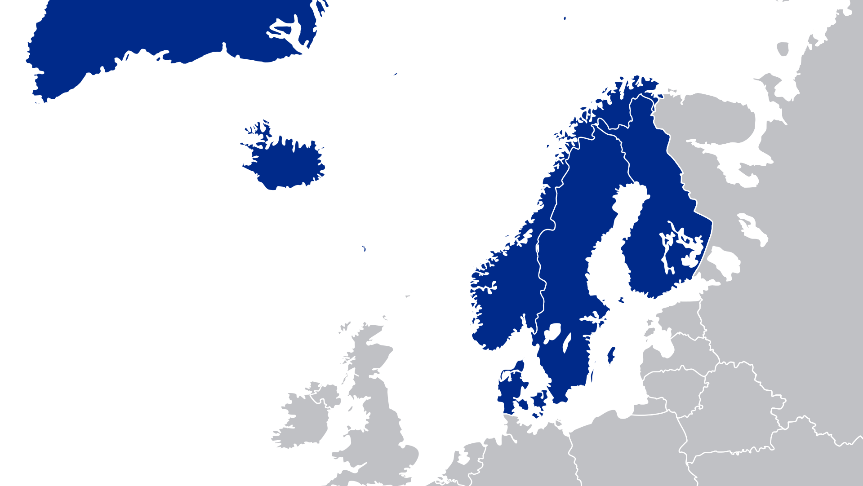
Arctic Green Shipping Corridor:
Torshavn – Reykjavik – Nuuk
Out of 81+ longlisted potential Green Shipping Corridors,
6 promising corridors were investigated further.
Umeå – Vasa,
Stockholm – Turku
Ystad – Rønne
Sandefjord – Strømstad
Hirtshals – Larvik
Short list of promising Green Shipping Corridors

Slide 13
High-level results of 3 potential Nordic GSCs
Potential green shipping corridors
GSC 1
GSC 2
GSC 3
Recommended focus for further study

Slide 14
Key barriers findings
Barriers identified
Actions to overcome barriers
Cost remains a significant challenge
Lack of fuel availability and bunkering infrastructure
Lack of safety requirements onboard and on shore for ammonia and hydrogen, limiting early uptake.
Cost- and risk-sharing mechanisms such as procurement policies, green financing, and Contract for Difference (CfD)
Creating a common Nordic “playground”:
Unified approach to matters relating to alternative maritime fuels safety
Promoting green fuel infrastructure
Build a market for green cargo transport, with standardized GHG emission accountability
The Nordics can be a first-mover region, driving progress and setting an example others can follow.
The Nordic countries have the resources and should exercise that responsibility by taking the ambitions into actions.

Slide 15
Focus forward – Nordic Roadmap project
Strengthen the collaboration platform
Develop a Nordic Roadmap
Piloting of selected fuels

Slide 16
For more information contact:
Dorthe Alida Slotvik
Ingeranne Strøm Nakstad
Ingeranne.strom.nakstad@dnv.com
dorthe.slotivk@dnv.com
+47 41275259
+47 90110696
https://futurefuelsnordic.com/

